Slide 1
Virtual Bead Loom Game
Acey Boyce
University of North Carolina Charlotte

Slide 2
So you want to make a CSDT game
Make a “Paper” version using the current CSDT.
Helps to ensure skill transfer
Use this to plan out game before you ever look at code

Slide 3
Demo

Slide 4
Problems
Answer Storage
  41x41 Data points
  Used own game as example
  Why store 1681 data when I can store <25 moves

Slide 5
Lag
Original tool very fast but when doing 2 graphs slows way down
Reason:
  Originally designed to redraw each time
Solution:
  Do not redraw

Slide 6
Tips for making puzzles
Start with goal in mind then make it
Do not worry about efficiency at first
Dissect into parts
Look for iteration

Slide 7
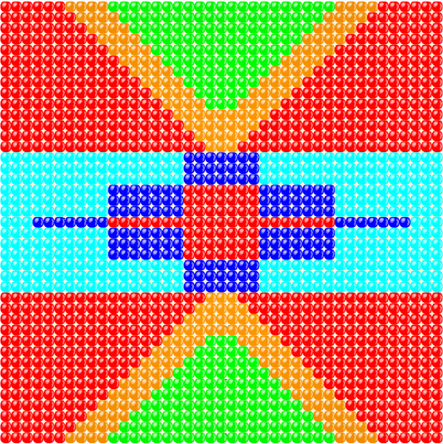
Tips for making puzzles

Slide 8
Prizes help
With kids even Dollar Store prizes greatly motivate
Given 30 minutes to do a puzzle they will redo the same puzzle over and over to beat each other

Slide 9
Difficulty
Do not be afraid to push the limits
Even if not Platinum Medal kids feel good when they complete a puzzle
They will start bead by bead if necessary then work on improving

Slide 10


Difficulty

